Slide 1
Microservices and DevOps
DevOps and Container Technology
Introduction
Henrik Bærbak Christensen

Slide 2
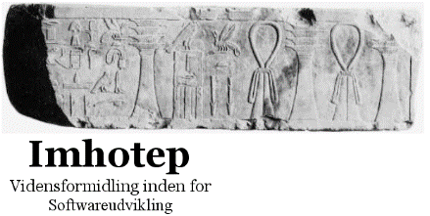
Henrik Bærbak Christensen
Associate Professor
Computer science department / Aarhus University
Interests: Software architecture, software engineering, teaching
Leader of part-time education in SW engineering
Industrial experience
Architect and developer for a product suite of meteorological systems for Danish airports.
Collaborations with Danish companies: Danfoss, SSE, KMD, B&O, Terma, Rambøll, Jyske Bank, Uber, and many others…
Imhotep: Courses and consulting, www.imhotep.dk
Have (had) 24/7/365 system in production

Slide 3
MSDO
The ‘fagpakke’ is a progression of three modules
DevOps and Container Technology
Scalable Microservices
Development project in Microservices and DevOps

Slide 4
The courses
Technology focus
The technologically oriented module
Understand and use the toolstack
Testability, and Modifiability are central Quality Attributes
Architecture focus
The architecturally oriented module
Architectures for systems, microservices
Availability, Scalability, Deployability are central QAs
Project focus
Have a go at your own (in groups ☺)

Slide 5
Some Story
Relatively new Fagpakke – 2nd time it runs…
Standing on Shoulders
Cloud computing and Architecture
Case Study, Docker, cloud stuff
Reliable Software and Architecture
Testing focus, CI and CD aspects
Reliability and Testing will play a major role
As it is vital for modern continuous deployment and DevOps

Slide 6
Disclaimer…
Things in this area moves extremely fast
Fifth time I do a Docker based course
The Docker Engine API has changed every single time ☹ !!!
The amount of tools out there is dauntingly large
I have probably missed a lot that would be beneficial
I am very open to your experience, recommendations, …
And share internally – learn from your fellow students !!!
Tools are picked from pedagogical considerations
Meaning some ‘widely used but hard to master’ is missing
The downside of a concrete case is…
I may not easily incorporate your recommendations

Slide 7
Course Website
All information can be found on BrightSpace
First time we use it so it is bound to go wrong ☹
So – feedback!
Or at the backdoor to slides…
https://baerbak.cs.au.dk/c/msdo/menu.html
[Demo]

Slide 8
Organization

Slide 9
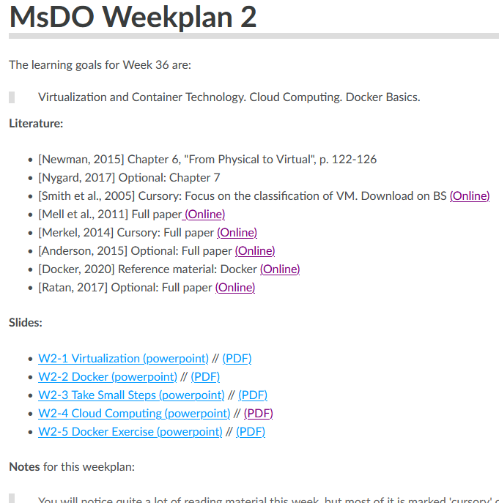
The major ’components’
Seminars – some may become virtual if you like…
Three in each course
7 hours on selected Fridays (and Tuesdays and …)
Lecturing, group exercises, discussions, lunch
Cover ~2-3 weeks of material
Weekplans (heartbeat!)
Learning goals, reading, (slides), exercises
Mandatory exercises = Primary learning vehicle
In groups of two -three persons
Must be passed to attend exam

Slide 10
Template for seminars
Presentations
outlining some topics
Work in groups
analysis, reading, application, discussion
Wrap-up
common understanding...

Slide 11
I will not cover all…
I am terribly chatty ☹
Maybe my stories are funny, or sleepy?
I will try to make working seminars
You will work more and listen less
I will not cover all
Not all slide sets are going to be presented
Reading material will be left – for reading!

Slide 12
Learning Vehicle
SkyCave

Slide 13
SkyCave
We will return shortly but…
SkyCave is a (almost) functionally complete interactive multi-user client-server system with a terrible UI.
Log into the ‘SkyCave’, create contents, and share messages with fellow ‘skycave explorers’…

Slide 14
SkyCave Demo: Local to Mxx
Start ‘daemon’
Start ‘cmd’
Interact.
Type ‘h’ for help

Slide 15
Learning Vehicle
MSDO’s focus is on state-of-art practice based upon best theory and methods
But we learn and try techniques in practice
Infrastructure as code: Write it for SkyCave
Testabilty: Ensure SkyCave is automated tested
Rest/Broker: Do it for SkyCave
DevOps: Do it for SkyCave
Microservices: Strangle SkyCave
Scaling: Make SkyCave run 10.000.000 users
X: Do X on SkyCave…

Slide 16
Literature

Slide 17
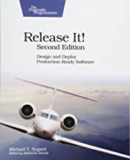
Sources
Main literature
[Newman, 2015] Sam Newman (2015) Building Microservices - Designing Fine-grained Systems. O'Reilly.
[Nygard, 2017] Michael T. Nygard (2017). Release It! Design and Deploy Production-Ready Software. 2nd Edition. Pragmatic Bookshelf

Slide 18
And…
My own little contribution on Broker and REST
Find it for 12$ at https://leanpub.com/frds/

Slide 19
Other Sources
Other material are often (research) papers
I will make them available through the ‘Literature’ link in Brightspace…
If I forget ☺, drop a note on the Forum …
And I assume a lot on patterns, TDD, testing, …
Use my two books or other sources with similar contents

Slide 20
A Personal Note
We are at a University, at Natural Science faculty
Ideally, all our material should be scientifically validated
Peer reviewed journals and papers from acknowledged sources…
Sadly, I find that CS researchers too often loose themselves into deep problems of little practical relevance
And more sadly do nothing about the real problems that industry has…
The interesting solutions all too often comes from
Accumulated experiences, expressed by gifted individuals

Slide 21
Science And Experience
Provable correct theory – statements that are true
Example: Design Patterns
DPs are accumulated design wisdom, expressed in a agreed-upon format
Example: Test-Driven Development
Beck and Cunningham formulated how they found coding should be done
Example: OO programming
First scientific evidence that it is more productive than procedural programming came in … 2012! (Or was it 2011?)

Slide 22
Bottom Line
This course builds upon accumulated best practices that are basically/often scientifically unverified!
Most of the course material is basically hypotheses!
Quite a few people find that it works in practice and improves one or more architectural/process quality attributes
Authors are gifted individuals, not researchers!
Which means lack of strict definitions and terminology!
Newman and Nygard often ‘define’ stuff by examples and vague handwaving ☹
I will try to give my own shot at more strict formulations ☺
I am a researcher and scientist so then it must be science ☺

Slide 23
Cutting Edge?
On-going debate in IT-Vest of what a fagpakke should do:
Present the cutting-edge research at the very frontier of human knowledge, presented by the most talented researchers at Danish universities
Had a complaint by a student about some papers were from 2004 ☺
I use whatever literature I find best communicate key knowledge and skills… Even if it is from 2004 ☺

Slide 24
The Exam
How it works…

Slide 25
Weird Exam Format
This course is highly tool and practice oriented.
The exam is a practical one…
Show that you have learned by doing it. Based on SkyCave!
1½ hour at the computer on (Date on BS)
Solve some exercises, upload to BS + Docker hub.
Individual!
Grade:
Basically confirm you group’s grade
I may change the grade if your performance is radically different from group performance…

Slide 26
Group Grade
Your group collects points for solving central exercises
The points accumulate (sounds reasonable, right?)
10 + 20 = 30
At a ‘checkout time’ I will convert points to a grade.
Algorithm: Given point interval from 0 to N points
Below 50% of N: Failed
Interval from 50% of N to N is divided into three brackets:
Low 30%: Given grade 4
Middle 30-80%: Given grade 7
Upper 80%-100%: Given grade 12
Subject to experience along the way…

Slide 27
Intent This Time
Relatively few exercises that award points
That is, manageable workload
Quite a few exercises that does not
Support for training
Avoid gamification and stressing and panicking
First time, people worked hard to get that extra 7 points ☹

Slide 28
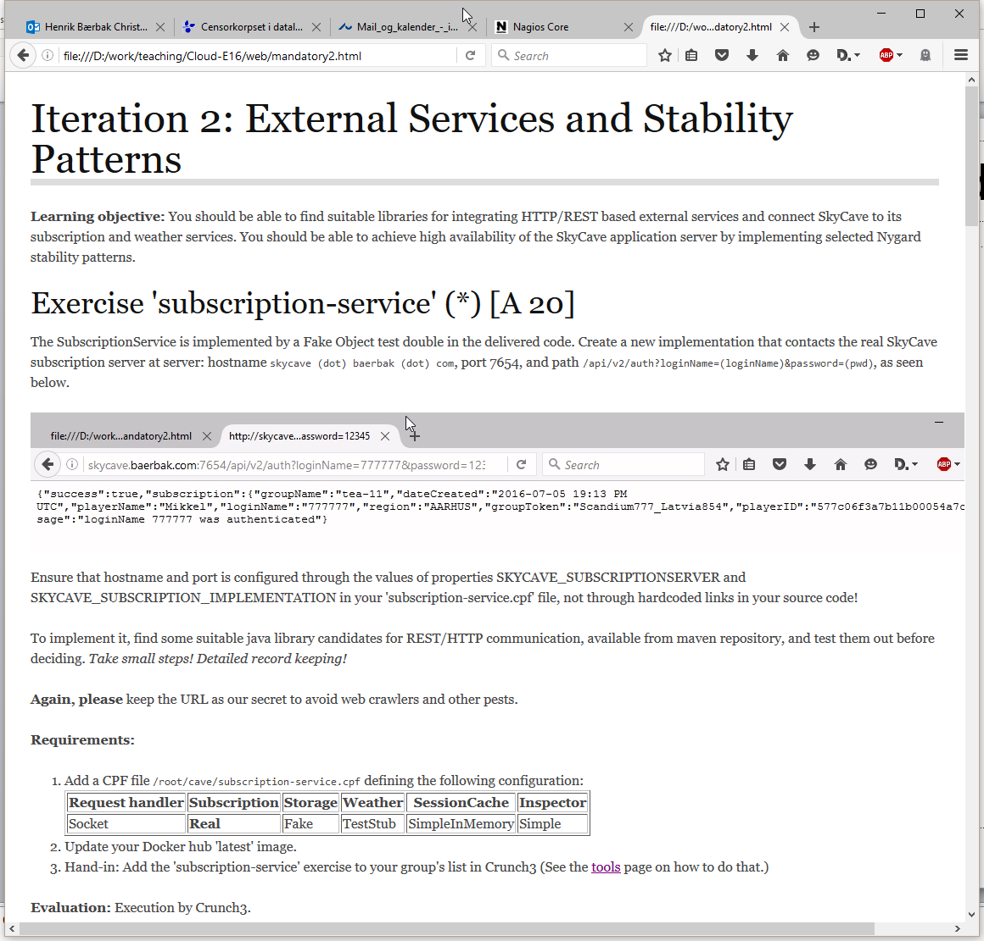
Exercises
Named exercises
(*) = mandatory
Must be solved
Ticket to final exam!
A/M
A = Crunch assess
M = Henrik assess
20
= Max points

Slide 29
Handing in
Either
M (= Manual)
Hand-in required material in BlackBoard
I will review, comment and grade your work, one attempt
A (= Automatic)
Mark the exercise as solved on Crunch web page
Crunch will re-run its test cases every hour from 07-23
Unlimited submission attempts
You simply improve your code base, Crunch will always run your latest Docker image
‘ ‘ (= None)
No hand-in or marking will take place
More info at Tools web page!

Slide 30
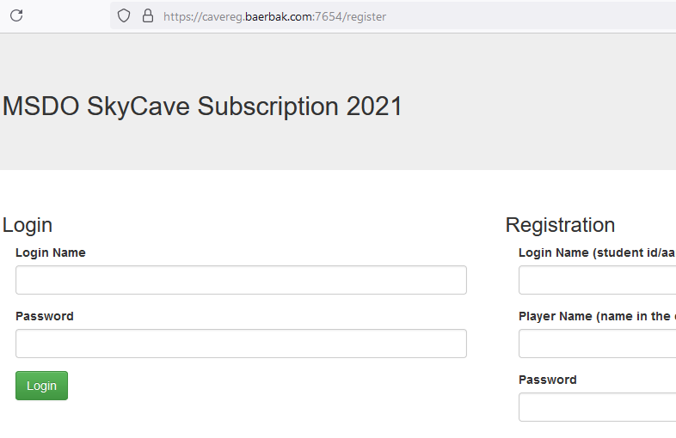
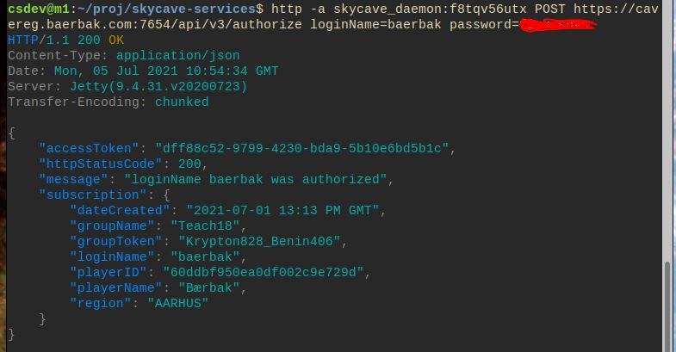
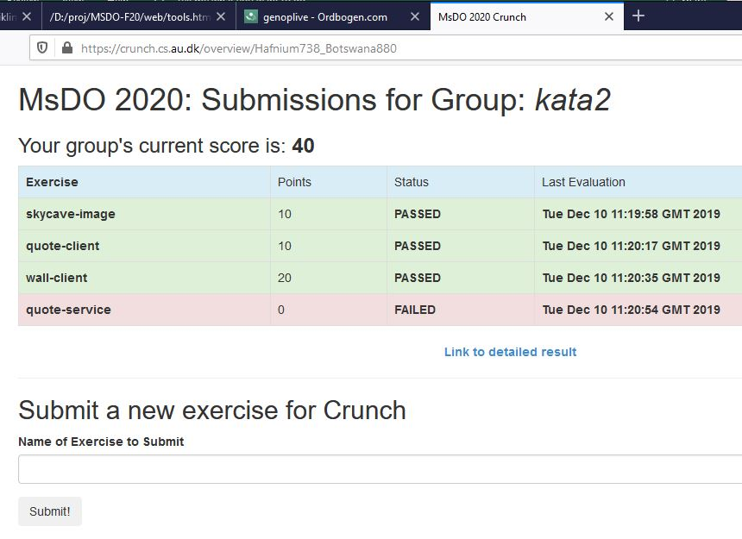
Crunch Hand-in
Is a rather weird system – sorry…
A) in one of the exercises, you register on ‘cavereg.baerbak.com:7654’
B) Authentication will return a ‘groupToken’ for your group
C) use that as link to crunch:

Slide 31
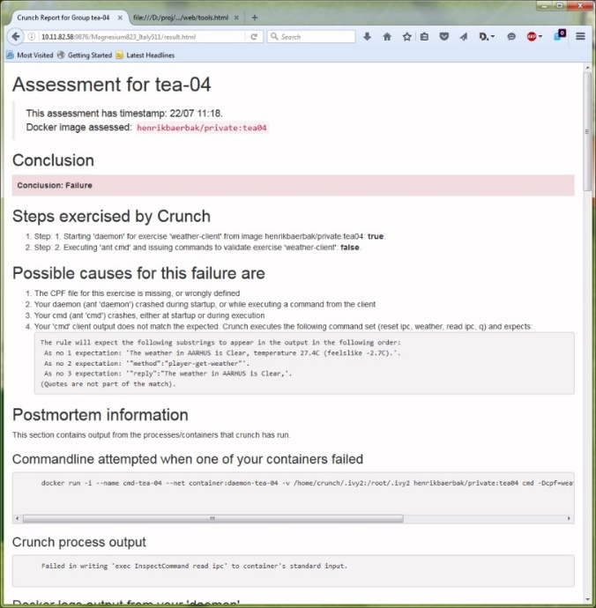
Feedback
A / Crunch exercises
Crunch will output diagnostics
Tell me if you need more info!
And – report any errors and issues!
Experience
Third time Crunch helps me out
Generally I get no complaints
Meaning: “It is probably working well”
But – tell me!!!
I had to update Crunch this time, as the Broker log system has changed…

Slide 32
Feedback
M / Brightspace exercises
Submit required artefacts to BS’s hand-in page
I will assess and provide feedback as necessary
Along some learning goals
Experience from F20
Many ‘full point’ hand-in’s => few comments

Slide 33
What’s New?
Huh?

Slide 34
What’s New?
Perhaps rather irrelevant for you ☺; you are following this course, not the previous one, right?
Anyway…
MSDO 2021
Finally, finally, I will cover a bit of security related stuff
Authentication using OAuth 2.0
Secure communication, TLS
Docker secrets (?), Docker image security hardening (?)
Fixing some terminology stuff concerning service tests…

Slide 35
Corona Experience
COVID-19 forced the F20 course to be almost entirely online
Online seminars using Zoom
Online exams
Additional ‘evening ½ hour FAQ sessions’ introduced
Experience Generally Positive
Positive
Works well; avoid transportation
Negative
Informal talks with other students
[me talking into a screen with no ability to find ‘blank eyes’]

Slide 36
So…
The exams will be online using Zoom
But do all seminars need to be physical?
Think about it !
And let us discuss further down the line…

Slide 37
There will be Dragons…

Slide 38
Why we must talk…

Slide 39
Our contract
I promise to guard you from my mistakes as best possible, fix problems as fast as possible
You need to promise me to tell me of problems!
We do not understand this exercise?
Most others will not either, and we must correct it
We have no clue as where to start on this exercise?
Ask me/on forum! Ask your fellow students! Google stack-overflow!
This score of our hand-in is completely wrong!!!
Tell me and explain why!

Slide 40
The Group Aspect
Working on the Mandatory

Slide 41
Working in Groups
Always somewhat of a challenge
May work excellent
Improve morale, support each other, supplementary skills, discussions lead to improved understanding
May work less well
Differences in goals, ambition levels, working patterns, skill sets, commitment
Only bad things happen quickly
Form groups, be open on problems, stay in touch with me, be prepared to change, rotate today

Slide 42
Let us start the process…
Please present yourself
Expected outcome of MSDO
Group aspects
Geography – where are you located
Working habits
Exposure to tool stack: Java, Gradle, docker and friends

Slide 43
Questions?

